Slide 1
Image Warping
Project 3

Slide 2
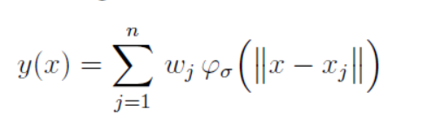

Task 3.1
Radial Basis Function Interpolation
Weighted Linear combination of Radial basis function

Slide 3
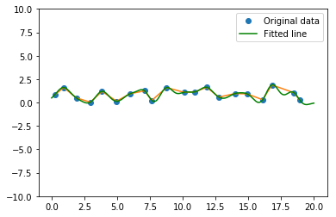
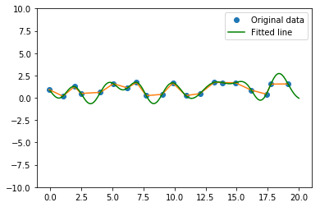
Task 3.1
Interpolation result for different σ
σ = 0.5 σ = 1.0

Slide 4
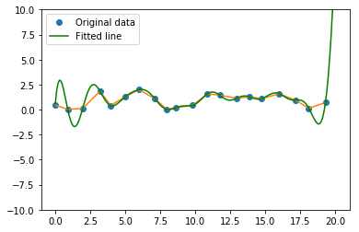
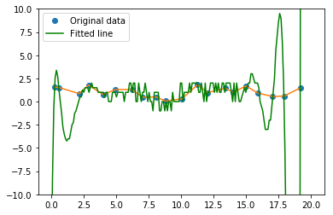
Task 3.1
Interpolation result for different σ (cont.)
σ = 2 σ = 4

Slide 5
Task 3.2
Implement Wave function on the image
Experiment with different parameterizations

Slide 6
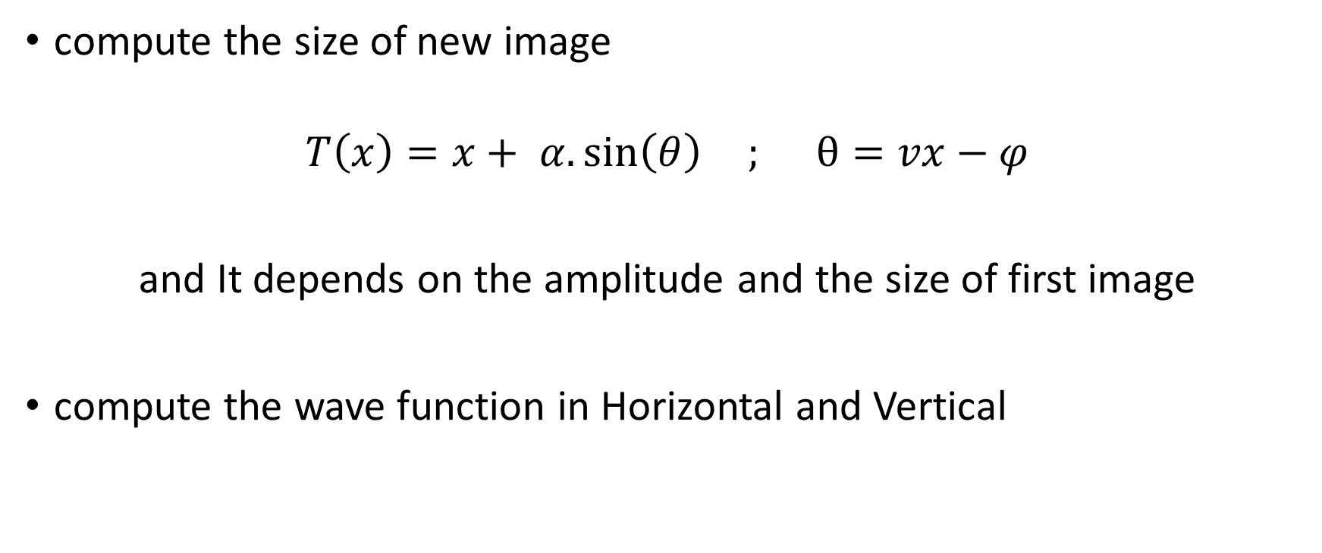

Slide 7
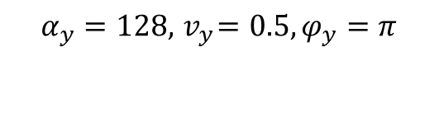
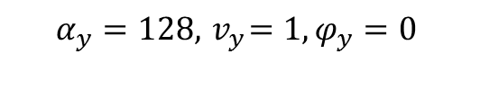
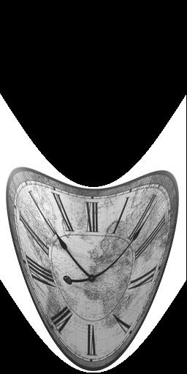
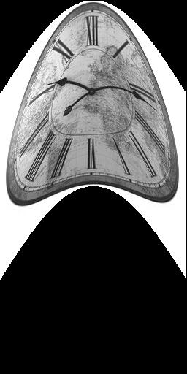
Results :

Slide 8
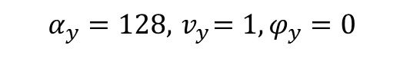
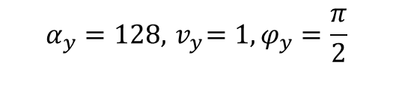
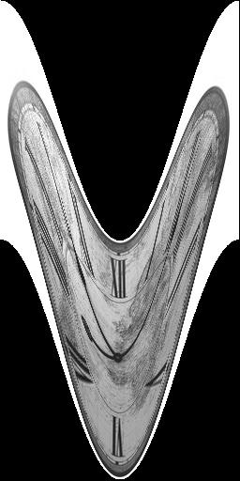
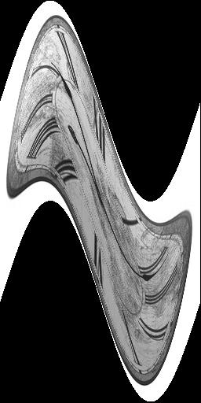

Slide 9
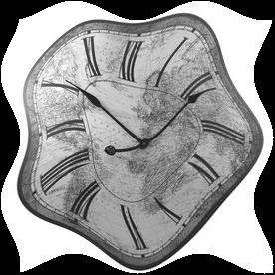
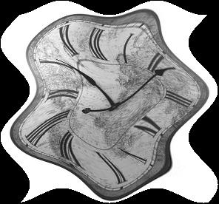
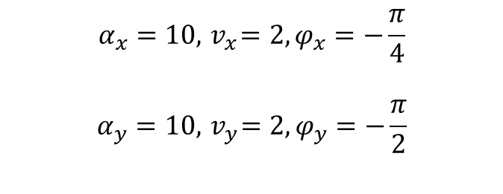
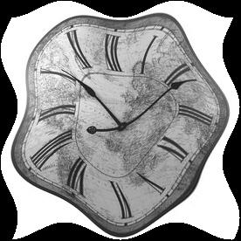


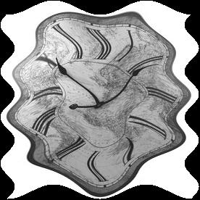


Slide 10
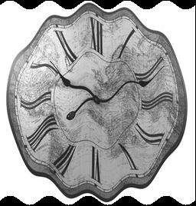
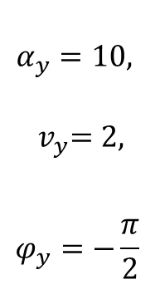
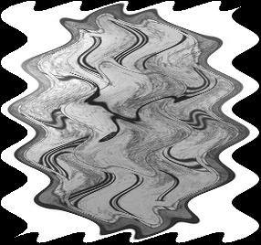
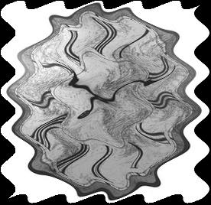
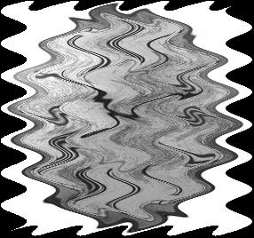

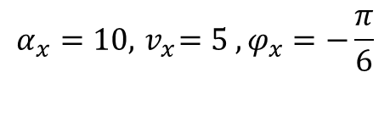

second

Slide 11
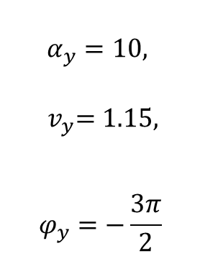
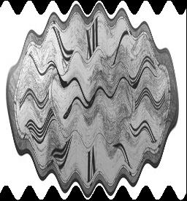
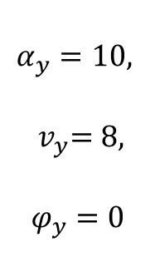
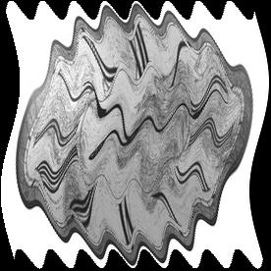
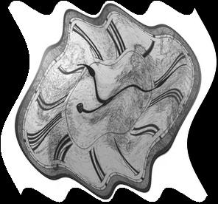
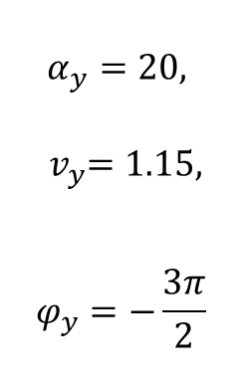
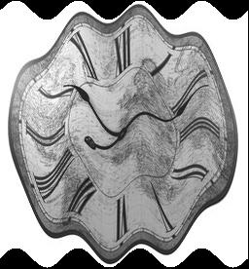
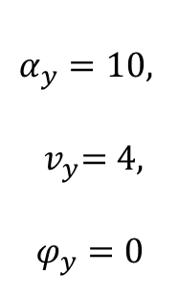

Slide 12
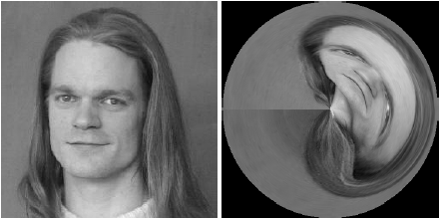
Task 3.3
Requirements: In this task we are required to perform a anamorphic image warping, and a discs-like extension of it. Apply this on clock.jpg.

Slide 13
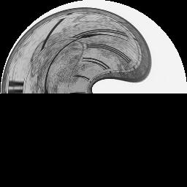
Task 3.3
Method: To achieve this, we need to map the image from r, 𝜑 plane onto the x, y plane using from_r_phi_plane_V2.
Set the rmax and phimax as a circle:
rmax = n/2
phimax = np.pi * 2
Shift the coordinates by n/2, m/2 to put image in the center:
np.meshgrid(np.arange(n) - n/2, np.arange(m) - m/2, sparse=True)
rotate 𝜑 by adding 𝜋
phis = phis + np.pi
Rotate the image for the correct origin
f = np.rot90(f)
Extension: radial discs:
rs = rs - rmin

Slide 14
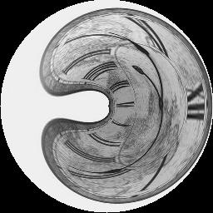
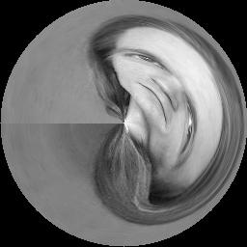
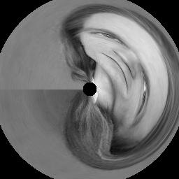
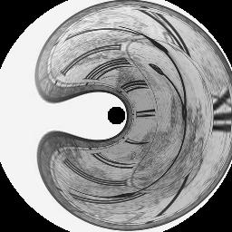
Task 3.3
Results:

Slide 15

Task 3.4 Apply 1D Gaussian on the to Polar representation of the image.
Represent the image in polar coordinates(r,ⲫ) instead of (x,y):
Take Grid(r,ⲫ) -> convert to planer (xs,ys) -> map to image(x,y) to get (r,ⲫ)
2. Apply Gaussian smoothing in one direction row wise or column wise to create the desired effect.
3. Convert the image back to the cartesian format.
Take Grid(x,y) -> convert to polar (rs,fis) -> map to image(r,ⲫ) to get (x,y)

Slide 16
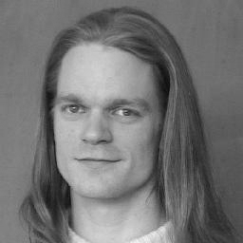
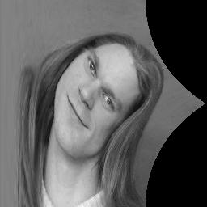
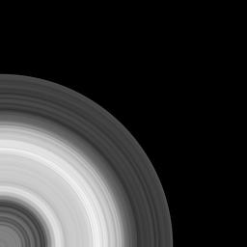

Representing in polar and back to planer
Planer
Polar
Naively Converted Back
Properly Done

Slide 17
There’s a catch here:
We need to correctly spread the rs and fis value we get to all rows and cols properly.
iis = (fis/fimax)*(rows-1)
jjs = (rs/rmax)*(cols-1)
2. Second in this case arctan2 returns values in [-𝝅,𝝅], we need to add 2𝝅 to correctly map negative values.

Slide 18
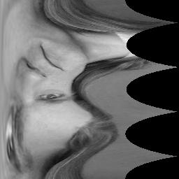
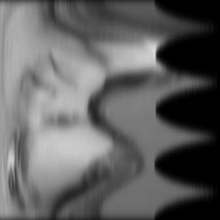
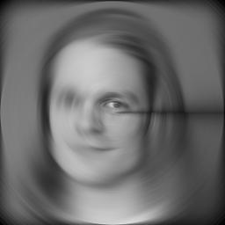
After handling both situations correctly:
Normal
Polar
Vertical Direction
Gaussian Smoothing
Converted Back
This artifact is generated due to improper handling of border pixel’s in vertical direction. If we choose wrap around option while convolving it goes away.

Slide 19
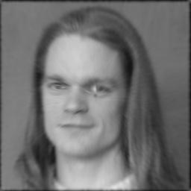
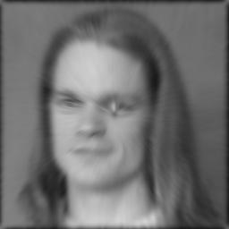


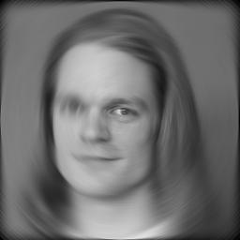
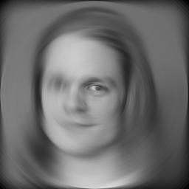
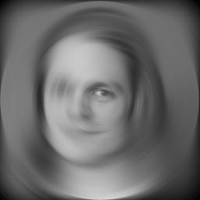

Sigma: 3 5 7 11

Slide 20








Row wise Gaussian
Col wise Gaussian
Both dir Gaussian

Slide 21






Sigma: 3 5 7 11

Slide 22
Task 3.5 : Perspective Mappings
Here we are trying to do perspective projection on an image (Clock) onto another image (Isle) to create augmented reality effect.
For doing so we have to evaluate the transformation matrix so that we can perform the transformation of all the pixels of the clock onto the Isle.
Typically, perspective transformation matrix (8 DoF) is evaluated by providing parameters (like translation amount, scale factor, rotation angle, and shearing amount), however, it can also be evaluated if we know the initial and final transformed position of the casted image.

Slide 23


Task 3.5
Given an initial coordinates and transformed coordinates points we computed a Matrix (which is used to map transformed coordinates to the original one)
Inversing which we get our perspective transformation matrix.
We compute the transformed coordinates for each pixel of the clock and assign its position (on the isle) with same color intensity value.

Slide 24
Thank You

